Slide 1
Precision-Recall and ROC Curves

Slide 2
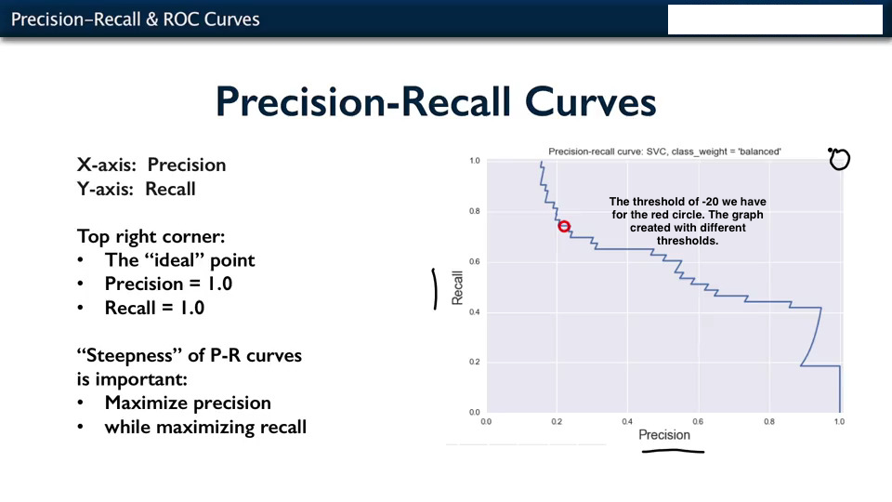

Slide 3
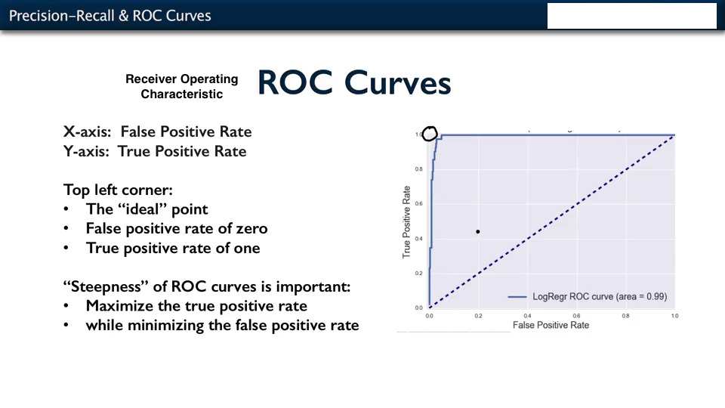

Slide 4
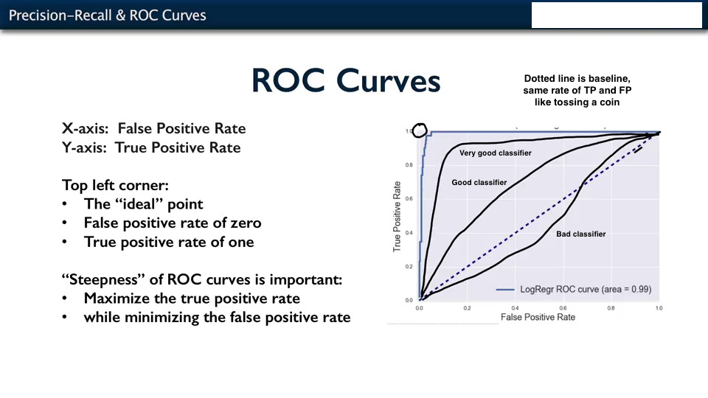

Slide 5
